Slide 1
The Qualtrics Tempo
Lesley Moyo and Tracy Gilmore
LOEX Annual Conference 2013

Slide 2
Create a new survey
Get started here

Slide 3
Assign a name and folder for the new survey

Slide 4
My Surveys tab
Select the survey to begin

Slide 5
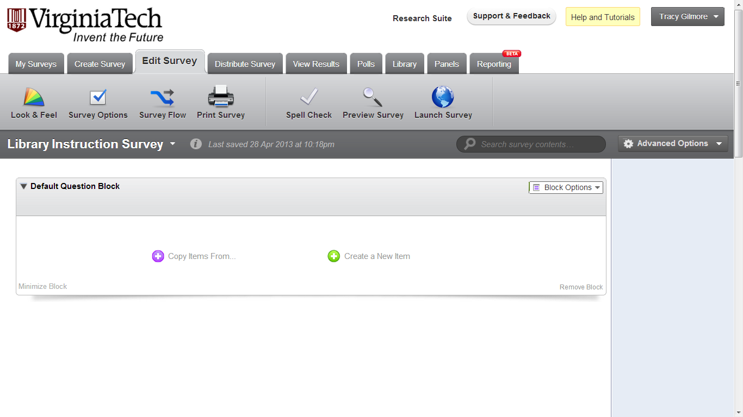
Edit the Survey
Begin each new question here

Slide 6
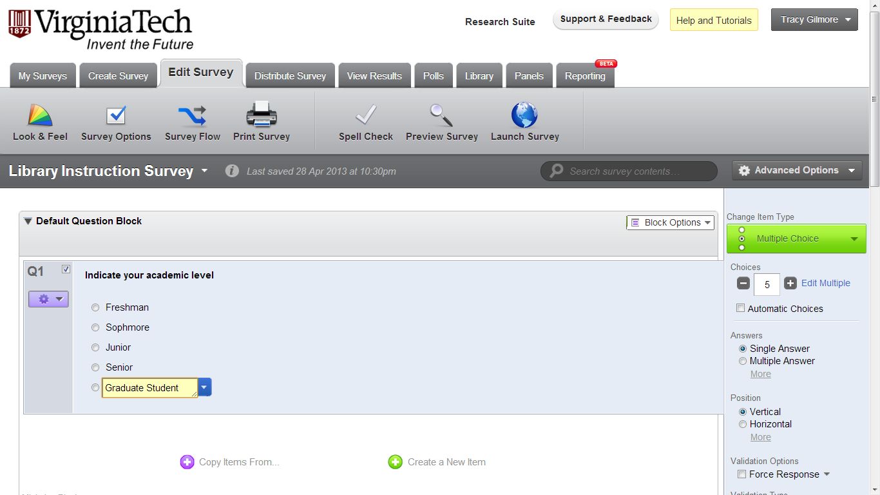
Create Multiple Choice Questions
Choose options on right

Slide 7
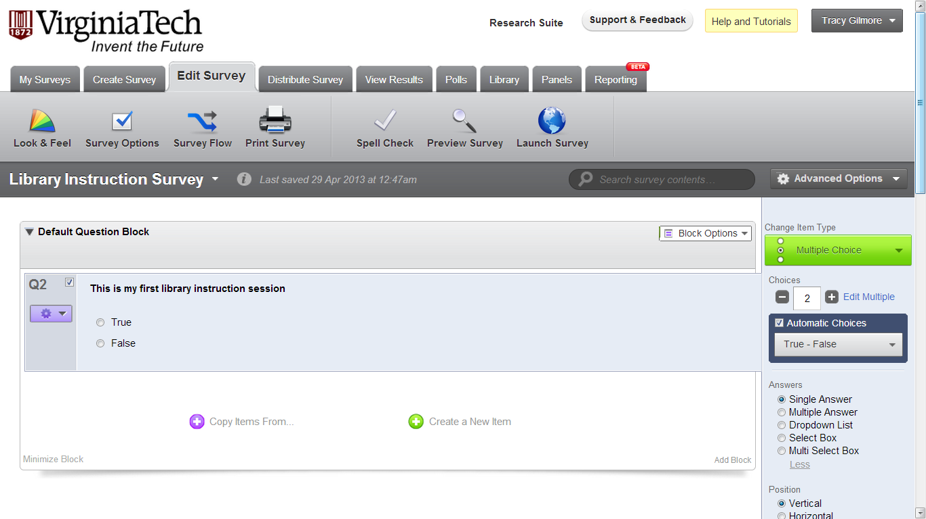
Create True/False questions using Automatic Choices
Choose from a list of automatic questions

Slide 8
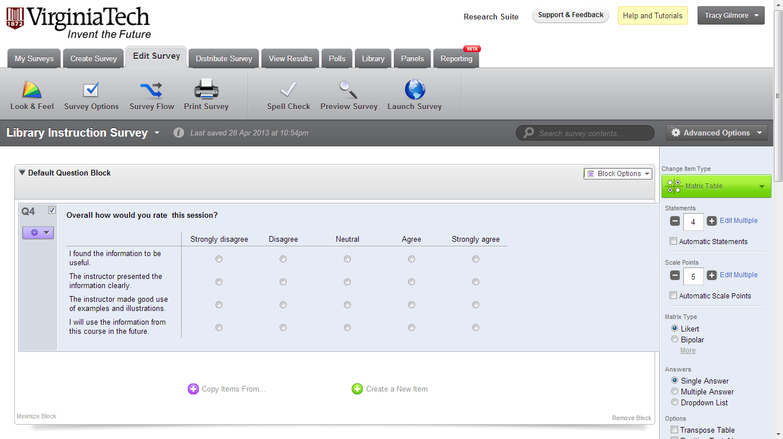
Create Likert Scale questions
Use the Matrix Table
Choose the number of statements and scale points

Slide 9
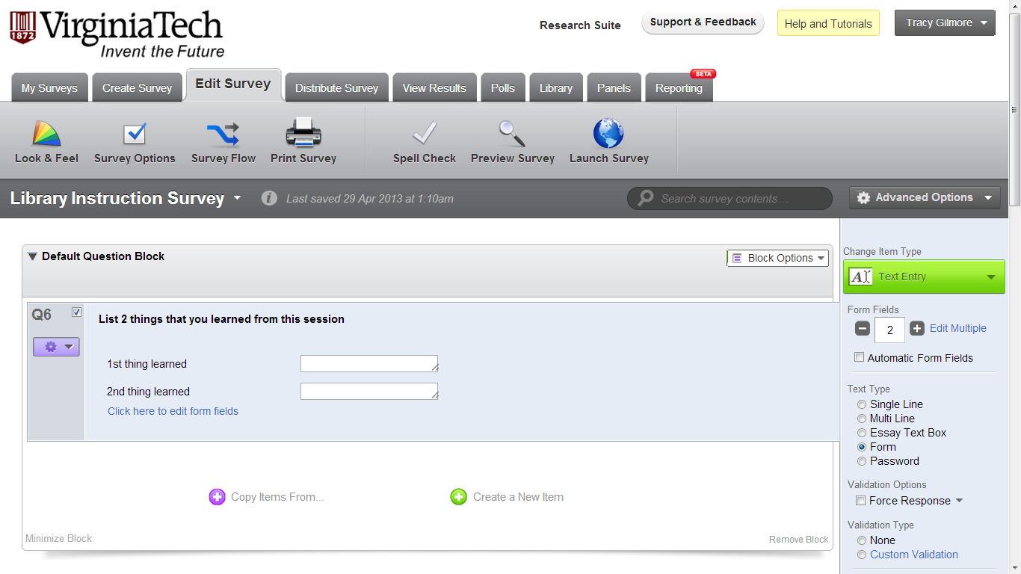
Create a text box or form
Choose Text Entry and Text Type

Slide 10
Change the font or edit content
Select the text for Rich Content Editor

Slide 11
Rich Text Editor

Slide 12
Move questions and change the order
Select the question
Select to move

Slide 13
Change the numbering
Change the item number

Slide 14
Remove Questions
Delete

Slide 15
Change the survey flow with Skip Logic
Skip logic parameters

Slide 16
Make questions conditional with Display Logic

Slide 17
Distribute and Activate the survey

Slide 18
Use the Anonymous Survey Link to distribute your survey

